Slide 1
GRID AND CLOUD COMPUTING
Cloud Virtualization and Clustering - II
Dr Mohammed Tawfik

Slide 2
UNIT 3:CLOUD VIRTUALIZATION & CLUSTERS
– Implementation levels of virtualization
– Difference between traditional and Virtual Machines
– More Beowulf Clusters
– PelicanHPC

Slide 3
Implementation Levels of Virtualization
Virtualization technology benefits the computer and IT industries by enabling users to share expensive hardware resources by multiplexing VMs on the same set of hardware hosts.
Virtual workspaces:
An abstraction of an execution environment that can be made dynamically available to authorized clients by using well-defined protocols,
Resource quota (e.g. CPU, memory share),
Software configuration (e.g. O/S, provided services).
Implement on Virtual Machines (VMs):
Abstraction of a physical host machine,
Hypervisor intercepts and emulates instructions
from VMs and allows management of VMs.
VMWare, Xen, etc.
Provide infrastructure API:
Plug-ins to hardware/support structures
App
App
App
OS
OS
OS
Hypervisor
Hardware
Virtualized Stack

Slide 4
Virtual Machines
VM technology allows multiple virtual machines to run on a single physical machine.
App
App
App
App
App
Xen
Guest OS
(Linux)
Guest OS
(NetBSD)
Guest OS
(Windows)
VMWare
VM
VM
VM
Virtual Machine Monitor (VMM) / Hypervisor
UML
Denali
Hardware
etc.
Performance: Para-virtualization (e.g. Xen) is very close to raw physical performance!

Slide 5
Virtualization in General
Advantages of virtual machines:
Run operating systems where the physical hardware is unavailable,
Easier to create new machines, backup machines, etc.,
Software testing using “clean” installs of operating systems and software,
Emulate more machines than are physically available,
Timeshare lightly loaded systems on one host,
Debug problems (suspend and resume the problem machine),
Easy migration of virtual machines (shutdown needed or not).
Run legacy systems!

Slide 6
What is the purpose and benefits?
Cloud computing enables companies and applications, which are system infrastructure dependent, to be infrastructure-less.
By using the Cloud infrastructure on “pay as used and on demand”, all of us can save in capital and operational investment!
Clients can:
Put their data on the platform instead of on their own desktop PCs and/or on their own servers.
They can put their applications on the cloud and use the servers within the cloud to do processing and data manipulations etc.
In computing, virtualization means to create a virtual version of a device or resource, such as a server, storage device, network or even an operating system where the framework divides the resource into one or more execution environments.

Slide 7
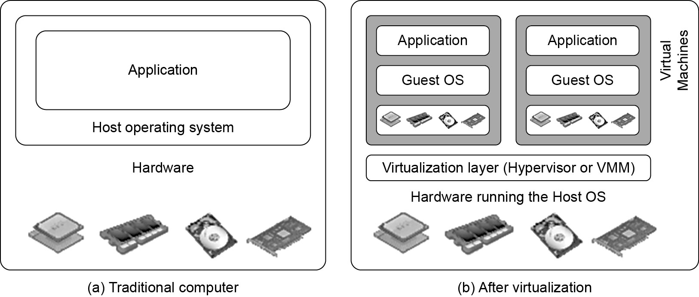
Difference between Traditional and Virtual machines
A traditional computer runs with a host operating system specially tailored for its hardware architecture
After virtualization, different user applications managed by their own operating systems (guest OS) can run on the same hardware, independent of the host OS.
The Virtualization layer is the middleware between the underlying hardware and virtual machines represented in the system, also known as virtual machine monitor (VMM) or hypervisor.
With sufficient storage, any computer platform can be installed in another host computer, even if they use processors with different instruction sets and run with distinct operating systems on the same hardware.

Slide 8
Virtualization Layers
The virtualization software creates the abstraction of VMs by interposing a virtualization layer at various levels of a computer system.
Common virtualization layers include:
the instruction set architecture (ISA) level,
hardware level,
operating system level,
library support level, and
application level

Slide 9
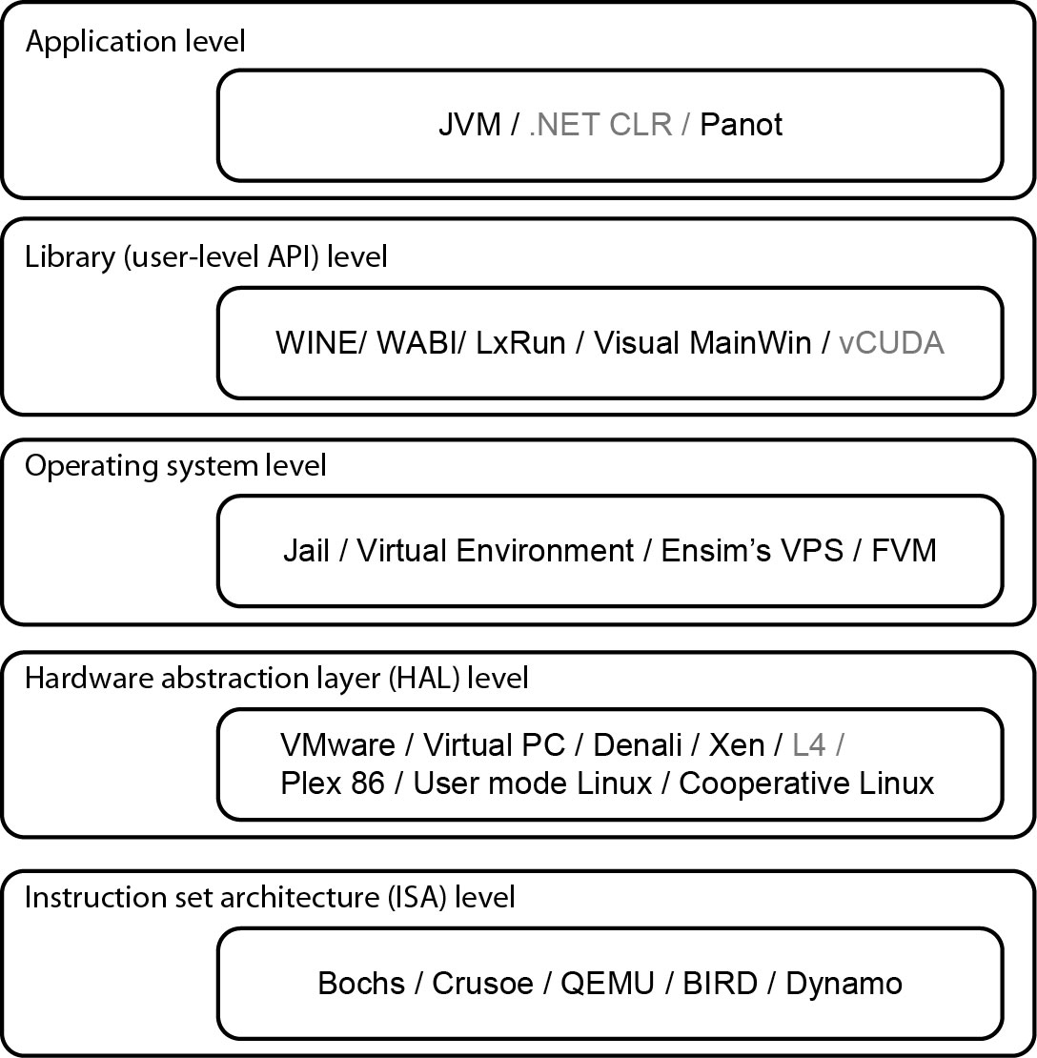
Virtualization Ranging from Hardware to Applications in Five Abstraction Levels
Notes:
- JVM: A Java virtual machine is an abstract computing machine that enables a computer to run a Java program. There are three notions of the JVM: specification, implementation, and instance.
- .NET CLR: The Common Language Runtime, the virtual machine component of Microsoft's .NET framework, manages the execution of .NET programs.
- WINE: Wine (recursive backronym for Wine Is Not an Emulator) is a free and open-source compatibility ..... product that uses some Wine code for its DirectX handling. VirtualBox, a virtual machine that uses some Wine code for its Direct3D handling.
- WABI: Sun used Windows Application Binary Interface to make Solaris more appealing to those needing Windows applications. The WABI software sits between an application and the operating system, intercepts the applications Windows calls, and translates them to "equivalent" Unix calls. On x86, the guest instructions were run directly on the processor, while they were emulated and/or binary translated on SPARC. WABI can also use an optional DOS emulator to run DOS applications.
- Lxrun is software for executing Linux a.out and ELF binaries (x86 only) on x86 Unix systems such as SCO OpenServer, SCO UnixWare, and later, Solaris. This is achieved by "remapping" Linux system calls on the fly. You need the Linux shared libraries that the application requires, as well as the Linux dynamic loader. Lxrun is thus a system call emulator. There are various caveats as to what kind of applications will not run, etc.
- MainWin: Microsoft had versions of Internet Explorer and Outlook Express for Solaris (SPARC). This was achieved not by porting them to Solaris, but by using API emulation. Mainsoft, the software company behind that effort, now has a product called Visual MainWin that allows for applications developed on Windows using Visual Studio to be run on Solaris, Linux, HP-UX, and AIX. It recompiles the applications from source on the deployment platform, using the latter's compilers.
- vCuda: vCUDA is a general-purpose graphics processing unit (GPGPU) computing solution for virtual machines (VMs).
- Jail: The FreeBSD jail mechanism is an implementation of operating system-level virtualization that allows system administrators to partition a FreeBSD-based computer system into several independent mini-systems called jails.
- A Virtual Environment, put simply, is an isolated working copy of Python which allows you to work on a specific project without worry of affecting other projects It enables multiple side-by-side installations of Python, one for each project.
- Ensim VPS solution virtualizes a server's native OS so it can be partitioned into isolated computing environments which operate independently of each other, just like a dedicated server.
- Featherweight Virtual Machine (FVM) is an OS-level virtual machine for Windows XP and Windows.
- VMware, Inc. is a subsidiary of Dell Technologies that provides cloud computing and platform virtualization.
- Windows Virtual PC is a virtualization program for Microsoft Windows. In July 2006 Microsoft released the Windows version as a free product.
- The Denali project seeks to enable an array of new networking and distributed middleware applications by designing and implementing lightweight protection domains, focusing in particular on the use of lightweight virtual machines and monitors. A virtual machine monitor (VMM) is a thin virtualization layer between hardware and ``guest'' operating systems, enabling hosts to safely execute untrusted applications and guest OS's inside a VM.
- Xen Project is a hypervisor using a microkernel design, providing services that allow multiple computer operating systems to execute on the same computer hardware concurrently. It was developed by the University of Cambridge and is now being developed by the Linux Foundation with support from Intel.
- The L4 Runtime Environment (L4Re) provides a basic set of services and abstractions, which are useful to implement and run user-level applications on top of the Fiasco.OC microkernel.
- Plex86 is a very lightweight Virtual Machine (VM) for running Linux/x86.
- User-Mode Linux is a safe, secure way of running Linux versions and Linux processes. Run buggy software, experiment with new Linux kernels or distributions, and poke around in the internals of Linux, all without risking your main Linux setup.
- Bochs is a portable x86 PC emulation software package that emulates enough of the x86 CPU, related AT hardware, and BIOS to run Windows, Linux, *BSD, Minix, and other OS's, all on your workstation.
- The Crusoe is a family of x86-compatible microprocessors developed by Transmeta and introduced in 2000. Crusoe was notable for its method of achieving x86 compatibility. Instead of the instruction set architecture being implemented in hardware, or translated by specialized hardware, the Crusoe runs a software abstraction layer, or a virtual machine, known as the Code Morphing Software (CMS). The CMS translates machine code instructions received from programs into native instructions for the microprocessor. In this way, the Crusoe can emulate other instruction set architectures (ISAs).
- QEMU is a hosted virtual machine monitor: it emulates CPUs through dynamic binary translation and provides a set of device models, enabling it to run a variety of unmodified guest operating systems. It also can be used with KVM to run virtual machines at near-native speed (requiring hardware virtualization extensions on x86 machines). QEMU can also do CPU emulation for user-level processes, allowing applications compiled for one architecture to run on another.
- Dynamo is an experimental web framework that runs on Elixir. It leverages the power of the Erlang VM to build highly performant and concurrent web applications. Dynamo's goals are performance, robustness and simplicity.
http://www.kernelthread.com/publications/virtualization/

Slide 10
1.Virtualization at Instruction Set Architecture (ISA) level:
At the ISA level, virtualization is performed by emulating a given ISA by the ISA of the host machine. Instruction set emulation leads to virtual ISAs created on any hardware machine. e.g, MIPS binary code can run on an x-86-based host machine with the help of ISA emulation.
With this approach, it is possible to run a large amount of legacy binary code written for various processors on any given new hardware host machine.
code interpretation – dynamic binary translation - virtual instruction set architecture (V-ISA)
Advantage:
It can run a large amount of legacy binary codes written for various processors on any given new hardware host machines
best application flexibility
Shortcoming & limitation:
One source instruction may require tens or hundreds of native target instructions to perform its function, which is relatively slow.
V-ISA requires adding a processor-specific software translation layer in the complier.

Slide 11
2.Virtualization at Hardware Abstraction level:
Hardware-level virtualization is performed right on top of the bare hardware.
On the one hand, this approach generates a virtual hardware environment for a VM.
On the other hand, the process manages the underlying hardware through virtualization.
The idea is to virtualize a computer’s resources, such as its processors, memory and I/O devices. The intention is to upgrade the hardware utilization rate by multiple users concurrently.
Advantage:
Has higher performance and good application isolation
Shortcoming & limitation:
Very expensive to implement (complexity)

Slide 12
3.Virtualization at Operating System (OS) level:
OS-level virtualization creates isolated containers on a single physical server and the OS instances to utilize the hardware and software in data centers. The containers behave like real servers.
OS-level virtualization is commonly used in creating virtual hosting environments to allocate hardware resources among a large number of mutually distrusting users.
Advantage:
Has minimal startup/shutdown cost, low resource requirement, and high scalability; synchronize VM and host state changes.
Shortcoming & limitation:
All VMs at the operating system level must have the same kind of guest OS
Poor application flexibility and isolation.

Slide 13
Virtualization at OS Level

Slide 14
Advantages of OS Extension for Virtualization
VMs at OS level has minimum startup/shutdown costs
OS-level VM can easily synchronize with its environment
Disadvantage of OS Extension for Virtualization
All VMs in the same OS container must have the same or similar guest OS, which restrict application flexibility of different VMs on the same physical machine.

Slide 15
4.Library Support level:
Since most systems provide well-documented APIs, such an interface becomes another candidate for virtualization.
Virtualization with library interfaces is possible by controlling the communication link between applications and the rest of a system through API hooks.
The software tool WINE has implemented this approach to support Windows applications on top of UNIX hosts.
Another example is the vCUDA which allows applications executing within VMs to leverage GPU hardware acceleration.
Advantage:
It has very low implementation effort
Shortcoming & limitation:
poor application flexibility and isolation

Slide 16
5.User-Application Level
Virtualization at the application level virtualizes an application as a VM. On a traditional OS, an application often runs as a process.
Therefore, application-level virtualization is also known as process-level virtualization.
The most popular approach is to deploy high level language (HLL) VMs. In this scenario, the virtualization layer sits as an application program on top of the operating system, and the layer exports an abstraction of a VM that can run programs written and compiled to a particular abstract machine definition.
Other forms of application-level virtualization are known as application isolation, application sandboxing, or application streaming.
Advantage:
has the best application isolation
Shortcoming & limitation:
low performance, low application flexibility and high implementation complexity.

Slide 17
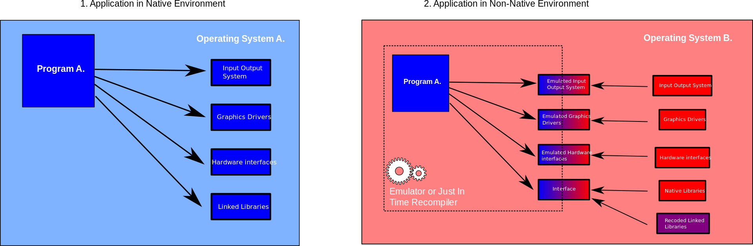
User-Application Level Virtualization

Slide 18
Virtualization Structures/Tools and Mechanisms
In general, there are three typical classes of VM architecture.
Figure on slide 7 showed the architectures of a machine before and after virtualization.
Before virtualization, the operating system manages the hardware.
After virtualization, a virtualization layer is inserted between the hardware and the operating system. In such a case, the virtualization layer is responsible for converting portions of the real hardware into virtual hardware.
Therefore, different operating systems such as Linux and Windows can run on the same physical machine, simultaneously.
Depending on the position of the virtualization layer, there are several classes of VM architectures, namely the hypervisor architecture, para-virtualization, and host-based virtualization.
The hypervisor is also known as the VMM (Virtual Machine Monitor). They both perform the same virtualization operations.

Slide 19
Hypervisor
A hypervisor is a hardware virtualization technique allowing multiple operating systems, called guests to run on a host machine. This is also called the Virtual Machine Monitor (VMM).
Type 1: bare metal hypervisor
sits on the bare metal computer hardware like the CPU, memory, etc.
All guest operating systems are a layer above the hypervisor.
The original CP/CMS hypervisor developed by IBM was of this kind.
Type 2: hosted hypervisor
Run over a host operating system.
Hypervisor is the second layer over the hardware.
Guest operating systems run a layer over the hypervisor.
The OS is usually unaware of the virtualization
Notes:
https://en.wikipedia.org/wiki/History_of_CP/CMS

Slide 20
Full Binary Translation and Host-based Virtualization
Depending on implementation technologies, hardware virtualization VM architectures can be classified into two categories:
Full virtualization and
Host-based virtualization.
Full virtualization does not need to modify the host OS. It relies on binary translation to trap and to virtualize the execution of certain sensitive, non virtualizable instructions.
In a host-based system, both a host OS and a guest OS are used. A virtualization software layer is built between the host OS and guest OS.
These two classes of VM architecture are introduced next.

Slide 21
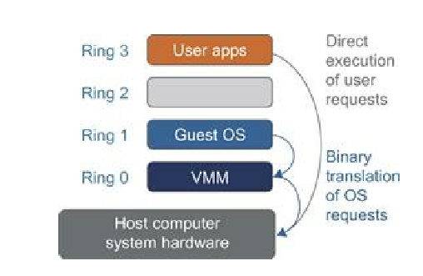
Binary Translation of Guest OS Requests Using a VMM
This approach was implemented by VMware and many other software companies.
VMware puts the VMM at Ring 0 and the guest OS at Ring 1. The VMM scans the instruction stream and identified the privileged, control- and behavior sensitive instructions.
When these instructions are identified, they are trapped into the VMM, which emulates the behavior of these instructions.
The method used in this emulation is called binary translation. Therefore, full virtualization combines binary translation and direct execution.

Slide 22
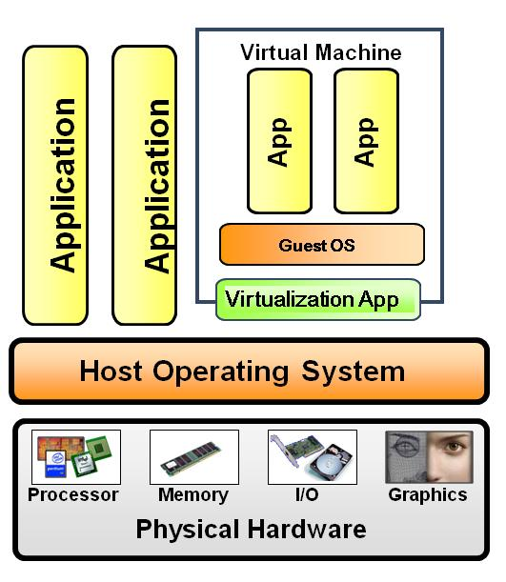
Host-Based Virtualization
An alternative VM architecture is to install a virtualization layer on top of the host OS. This host OS is still responsible for managing the hardware.
This host-based architecture has some distinct advantages. First, the user can install this VM architecture without modifying the host OS. The virtualizing software can rely on the host OS to provide device drivers and other low-level services. This will simplify the VM design and ease its deployment.
Second, the host-based approach appeals to many host machine configurations. Compared to the hypervisor/VMM architecture, the performance of the host-based architecture may also be low.

Slide 23
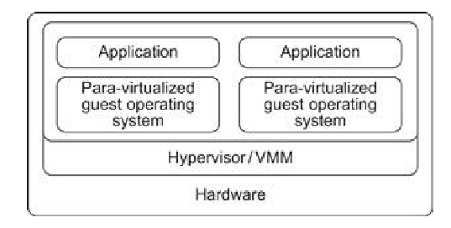
Para-virtualization
Para-virtualization needs to modify the guest operating systems.
A para-virtualized VM provides special APIs requiring substantial OS modifications in user applications.
Performance degradation is a critical issue of a virtualized system.

Slide 24
Full Virtualization vs. Para-Virtualization
Full virtualization
Does not need to modify guest OS, and critical instructions are emulated by software through the use of binary translation.
VMware Workstation applies full virtualization, which uses binary translation to automatically modify x86 software on-the-fly to replace critical instructions.
Advantage: no need to modify OS.
Disadvantage: binary translation slows down the performance.
Para virtualization
Reduces the overhead, but cost of maintaining a paravirtualized OS is high.
The improvement depends on the workload.
Para virtualization must modify guest OS, non-virtualizable instructions are replaced by hyper calls that communicate directly with the hypervisor or VMM.
Para virtualization is supported by Xen, Denali and VMware ESX.

Slide 25
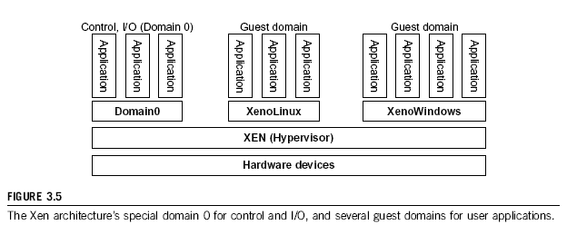
The XEN Architecture
Xen is an open source hypervisor program developed by Cambridge University. Xen is a micro-kernel hypervisor, which separates the policy from the mechanism.
Xen does not include any device drivers natively . It just provides a mechanism by which a guest OS can have direct access to the physical devices.
As a result, the size of the Xen hypervisor is kept rather small. Xen provides a virtual environment located between the hardware and the OS.

Slide 26
CPU Virtualization
Virtualization of CPU, Memory, and I/O Devices
A VM is a duplicate of an existing computer system in which a majority of the VM instructions are executed on the host processor in native mode. Thus, unprivileged instructions of VMs run directly on the host machine for higher efficiency. Other critical instructions should be handled carefully for correctness and stability.
The critical instructions are divided into three categories: privileged instructions, control–sensitive instructions, and behavior-sensitive instructions.
Privileged instructions execute in a privileged mode and will be trapped if executed outside this mode.
Control-sensitive instructions attempt to change the configuration of resources used. Behavior-sensitive instructions have different behaviors depending on the configuration of resources, including the load and store operations over the virtual memory.

Slide 27
A CPU architecture is virtualizable if it supports the ability to run the VM’s privileged
and unprivileged instructions in the CPU’s user mode while the VMM runs in supervisor mode.
When the privileged instructions including control- and behavior-sensitive instructions of a VM are executed, they are trapped in the VMM. In this case, the VMM acts as a unified mediator for hardware access from different VMs to guarantee the correctness and stability of the whole system. However, not all CPU architectures are virtualizable.
RI SC CPU architectures can be naturally virtualized because all control and behavior-sensitive instructions are privileged instructions.
On the contrary, x86 CPU architectures are not primarily designed to support virtualization.

Slide 28
Memory Virtualization
Virtual memory virtualization is similar to the virtual memory support provided by modern operating systems. I n a traditional execution environment, the operating system maintains mappings of virtual memory to ma chine memory using page tables, which is a one-stage mapping from virtual memory to machine memory.
However, in a virtual execution environment, virtual memory virtualization involves sharing the physical system memory in RAM and dynamically allocating it to the physical memory of the VMs.
That means a two-stage mapping process should be maintained by the guest OS and the VMM, respectively: virtual memory to physical memory and physical memory to machine memory.

Slide 29
I/O Virtualization
there are three ways to implement I/O virtualization: full device emulation, para-virtualization, and direct I/O.
I/O virtualization. Generally, this approach emulates well-known, real-world devices. All the functions of a device or bus infrastructure, such as device enumeration, identification, interrupts, and DMA, are replicated in software. This software is located in the VMM and acts as a virtual device.
The para-virtualization method of I/O virtualization is typically used in Xen. It is also known as the split driver model consisting of a frontend driver and a backend driver. It achieves beer device performance than full device emulation, it comes with a higher CPU overhead
Direct I/O virtualization lets the VM access devices directly. It can achieve close-to native performance without high CPU costs.

Slide 30
Diskless Beowulf Cluster - PelicanHPC
PelicanHPC is a rapid (around 5 minutes, when you know what you're doing) means of setting up a high performance computing (HPC) cluster for parallel computing using MPI.
We will see what PelicanHPC does, how to use the released CD images to set up a HPC cluster, and some basic examples of usage.

Slide 31
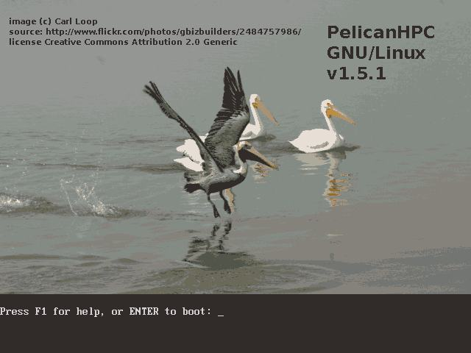

Slide 32
PelicanHPC Installation
PelicanHPC is a distribution of GNU/Linux that runs as a "live CD" (or as a virtualization appliance).
If the ISO image file is burnt to a CD/Flash Disk, the resulting CD/Flash Disk can be used to boot a computer.
The computer on which PelicanHPC is booted is referred to as the "frontend node", which is the computer that the user interacts with.

Slide 33
Runing the PelicanHPC Cluster
Once PelicanHPC is running, a script ­ "pelican_setup" ­ may be run. This script configures the frontend node as a netboot server.
After this has been done, other computers can boot copies of PelicanHPC over the network.
These other computers are referred to as "compute nodes".
PelicanHPC configures the cluster made up of the frontend node and the compute nodes so that MPI­based parallel computing may be done.

Slide 34
PelicanHPC Advantages
A "live CD" such as PelicanHPC does not use the hard disk of any of the nodes, so it will not destroy or alter your installed operating system.
When the PelicanHPC cluster is shut down, all of the computers are in their original state, and will boot back into whatever operating system is installed.

Slide 35
PelicanHPC Features
The frontend node can be a real computer booted using a CD, or a virtual machine that is booted using the CD image file.
With this second option, PelicanHPC can be used at the same time as the normal work environment, which may be any of the common operating systems.
The compute nodes are normally real computers, but they can also be virtual.

Slide 36
PelicanHPC Features
Supports MPI­based parallel computing using Fortran (77, 90), C, C++, and GNU Octave (using MPITB).
Offers the Open MPI and LAM/MPI implementations of MPI.
Cluster can be resized to add or remove nodes using the "pelican_restarthpc" command.
Notes:
Octave Linux users in a cluster with several PCs can use MPITB in order to call MPI library routines from within the Octave environment.
https://github.com/ssrb/mpitb

Slide 37
PelicanHPC Features
Easily extensible to add packages. Also easily modifiable, since the PelicanHPC CD image is created using a single script that uses the Debian Live system for creating a live CD image.
For this reason, the distributed version is basic and lightweight.
Versions exist for 32 bit CPUs (Pentium 4, Core, Sempron) and for 64 bit CPUs (Opteron, Turion, Core 2, etc.)

Slide 38
PelicanHPC Features
Contains example software:
Linpack HPL benchmark and extensive examples that use MPITB for GNU Octave.

Slide 39
Limitations and Requirements
The compute nodes must be booted over the network. This is an option offered by all modern networking devices supplied with motherboards, but it often must be enabled in the BIOS setup.
Enable it, and give it higher priority that booting from hard disk or other sources.
If you have a network card that won't do netboot, it is possible to work around this using rom­o­matic.

Slide 40
PelicanHPC Pros and Cons
LiveCD for instant cluster creation
Advantages
Easy to use
A lot of built-in software
Disadvantages
Not persistent
Difficult to add software

Slide 41
Worth Reading....
http://www.pelicanhpc.org/academic_work.html
http://distrowatch.com/table.php?distribution=pelicanhpc
http://linux.softpedia.com/get/System/Operating-Systems/Linux-Distributions/PelicanHPC-38025.shtml
http://www.linux-magazine.com/Online/News/Number-Crunching-with-Pelican-HPC-2.0

Slide 42
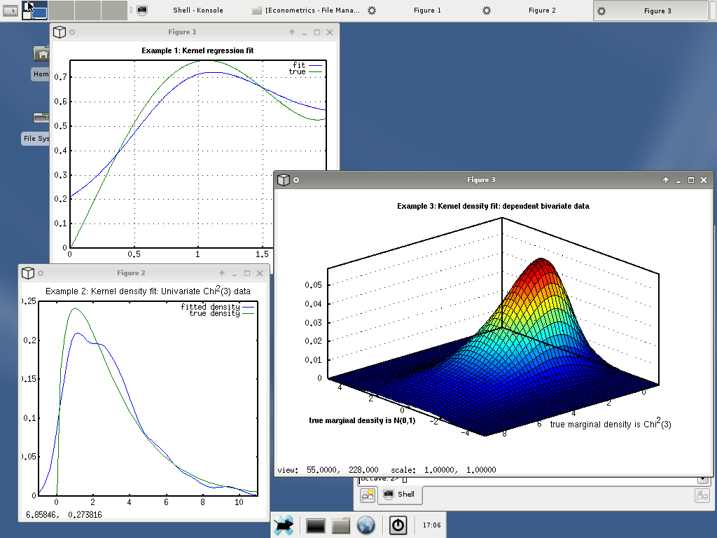
PelicanHPC Simulations

Slide 43
References
Kai Hwang, Geoffery C. Fox and Jack J. Dongarra, “Distributed and Cloud Computing: Clusters, Grids, Clouds and the Future of Internet”,
http://klucloudseminar.weebly.com/
http://cloudcomputingnet.com/cloud-computing-deployment-models/
http://gcauble.com/products/cloud-computing/
http://www.levelcloud.net/why-levelcloud/cloud-education-center/advantages-and-disadvantages-of-cloud-computing/
www.cse.unr.edu/~mgunes/cpe401/cpe401sp12/lect15_cloud.ppt
http://slideplayer.com/slide/5862268/
https://msdn.microsoft.com/en-us/magazine/dn520239.aspx
http://www.thoughtsoncloud.com/2014/01/cloud-computing-defined-characteristics-service-levels/

Slide 44
Assignment #4
Briefly Explain the Virtualization Technologies mentioned in slide 9.

